Slide 1
National Forest Foundation Grant
By : Theresa Wheat

Slide 2
NFF Grant Update
Objective: Increase community awareness and education by completing a longer Netflix narrative style 15-25 minute documentary
Blending expert interviews, real-life footage and personal stories
Draft title – Guardians of the Forest: Fuels Reduction Work in North Idaho.
Included are two Additionally, video snippets
Additionally, several 1-3 minute versions of the documentary tailored for social media platforms such as Instagram Reels, Facebook and YouTube Short
Shared Stewardship Project is the location for these videos
Focus on unmanaged and managed forests including fuel reduction work completed and locations where fire went through and now has two+ years re-growth
Funding increased from $6,312 to $31,312
Due dates: October 31, 2025; Final Report due to NFF by November 30, 2025

Slide 3
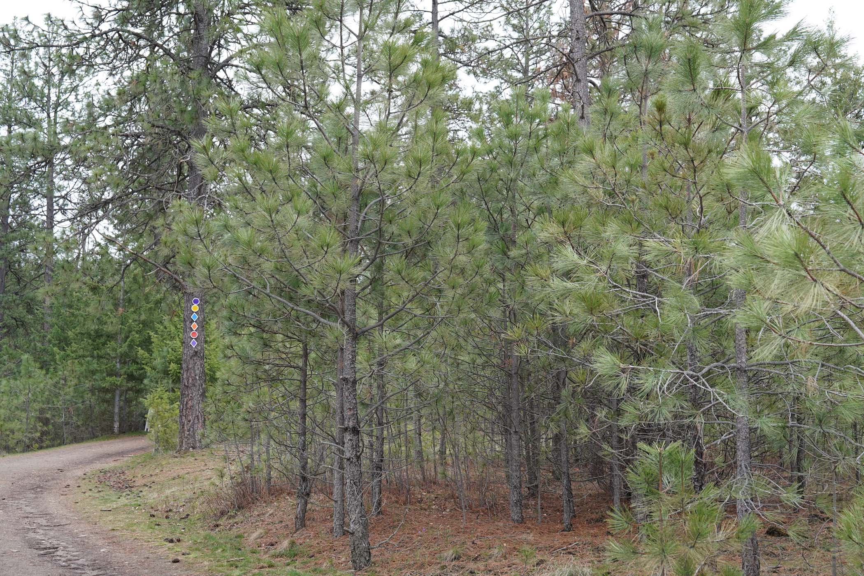
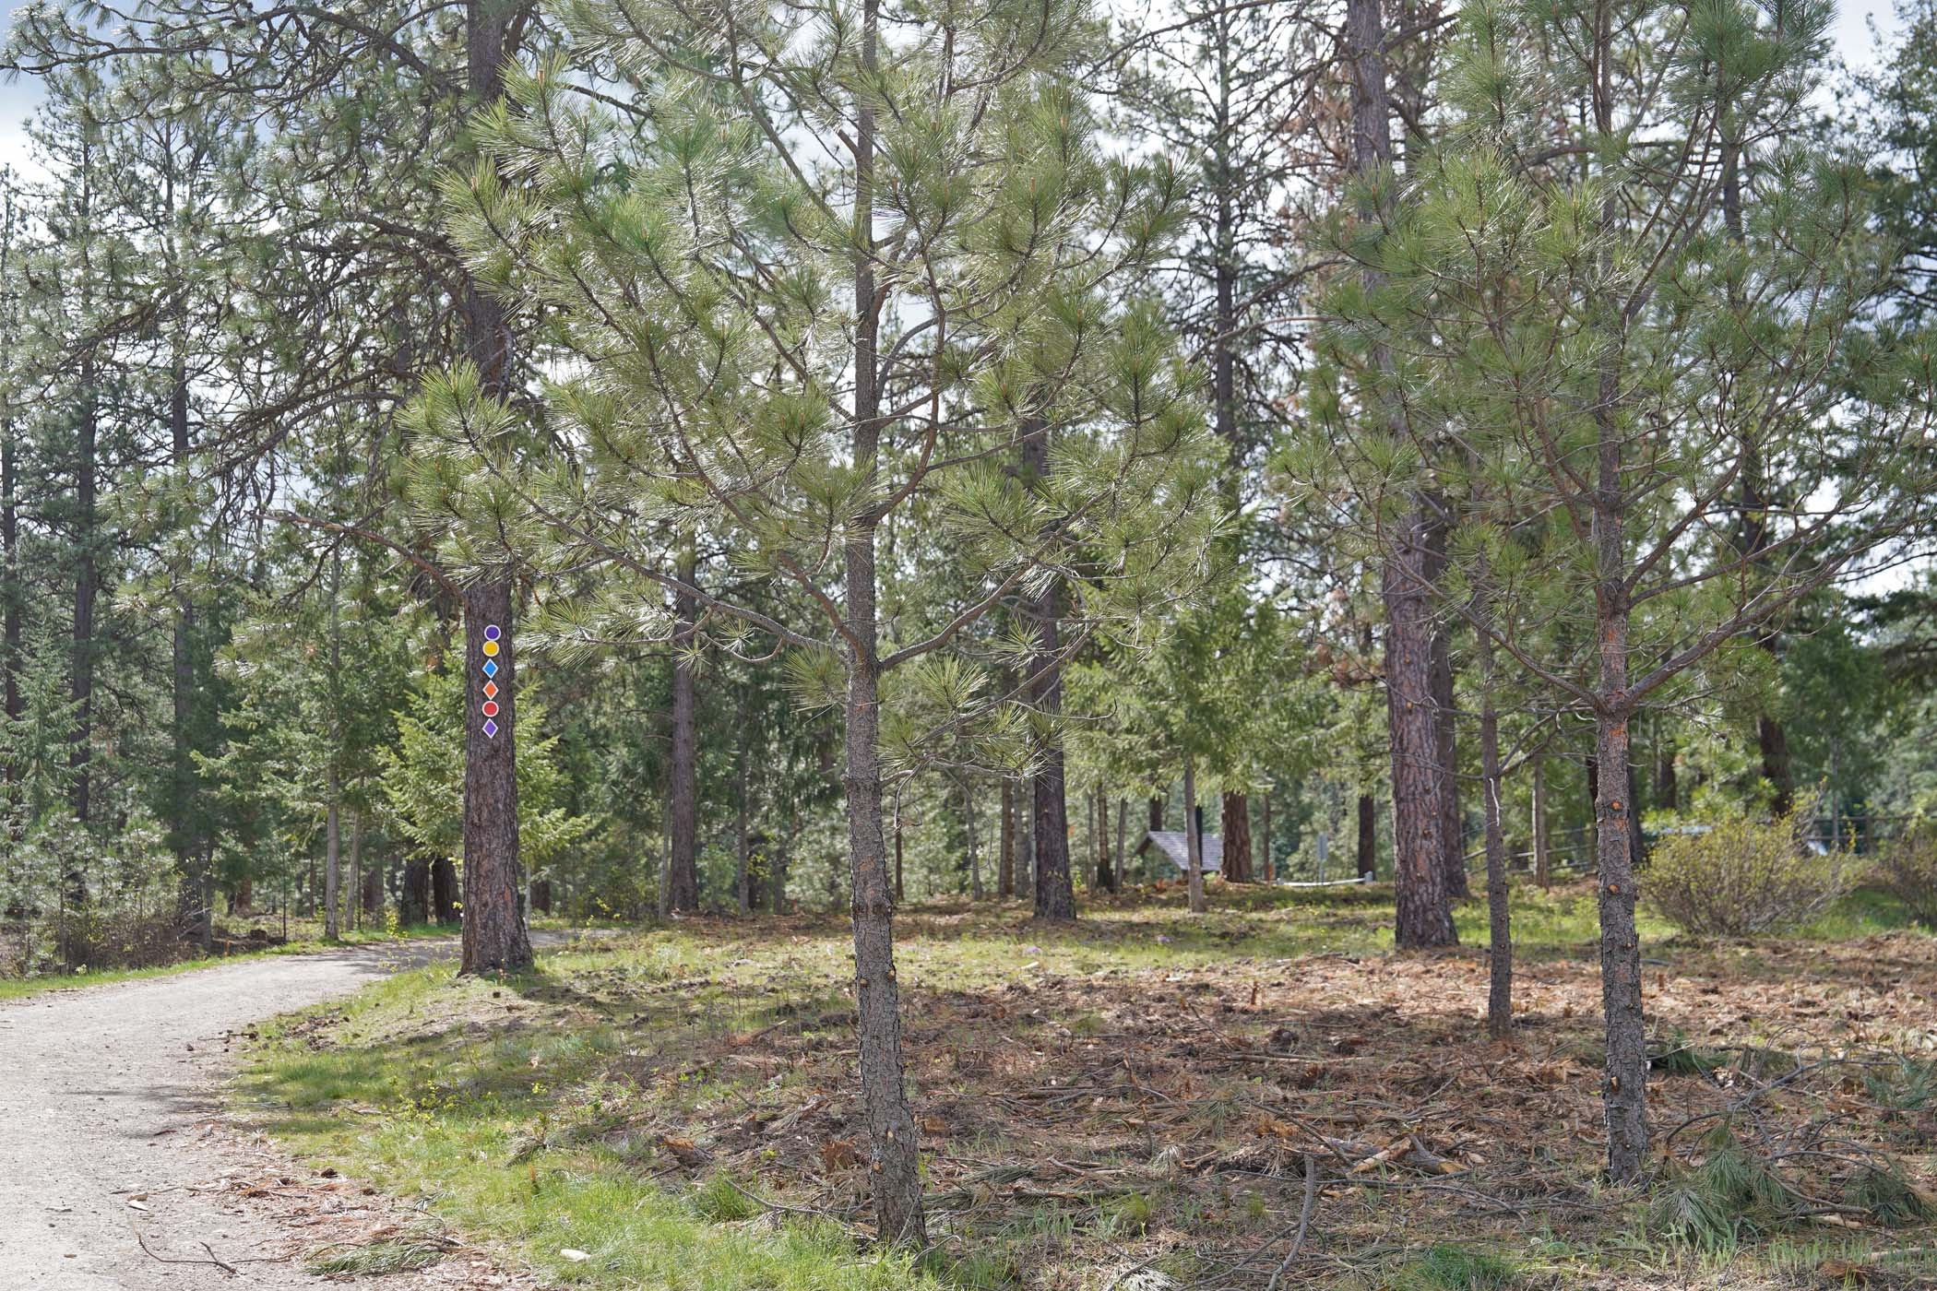
Unit 1 : Post Falls Community Forest
75 acres targeted for treatment post 2023 Parkway Fire
before:
after:

Slide 4
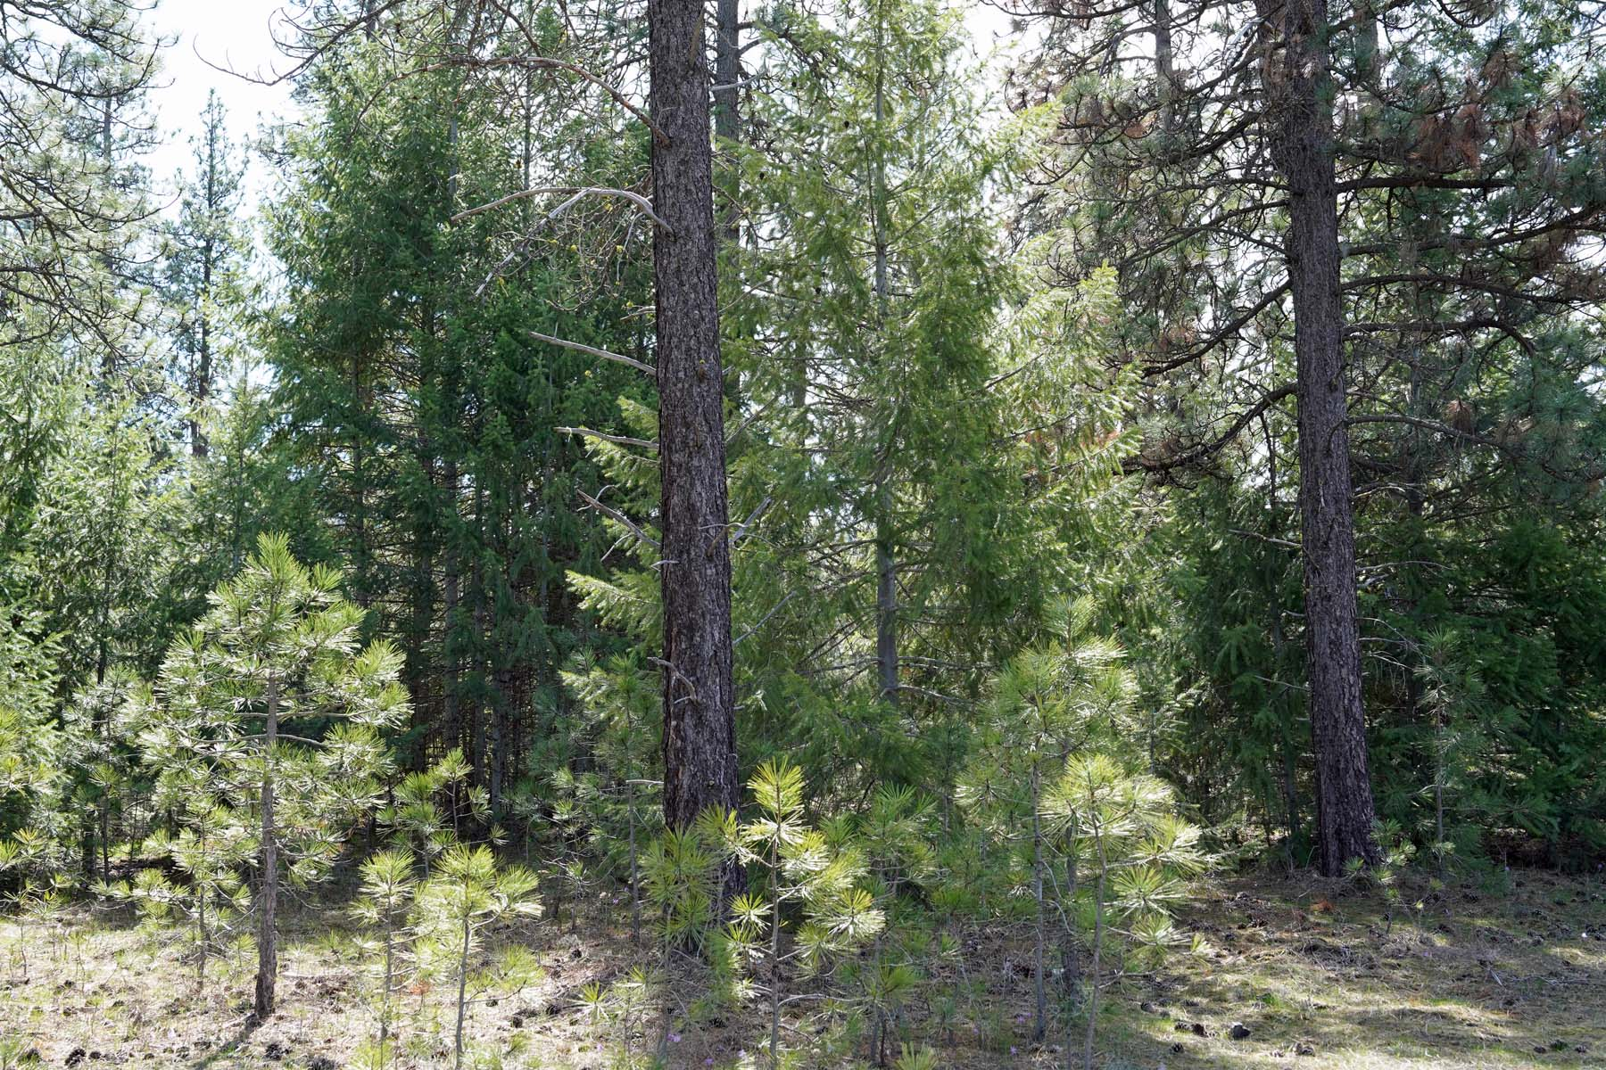
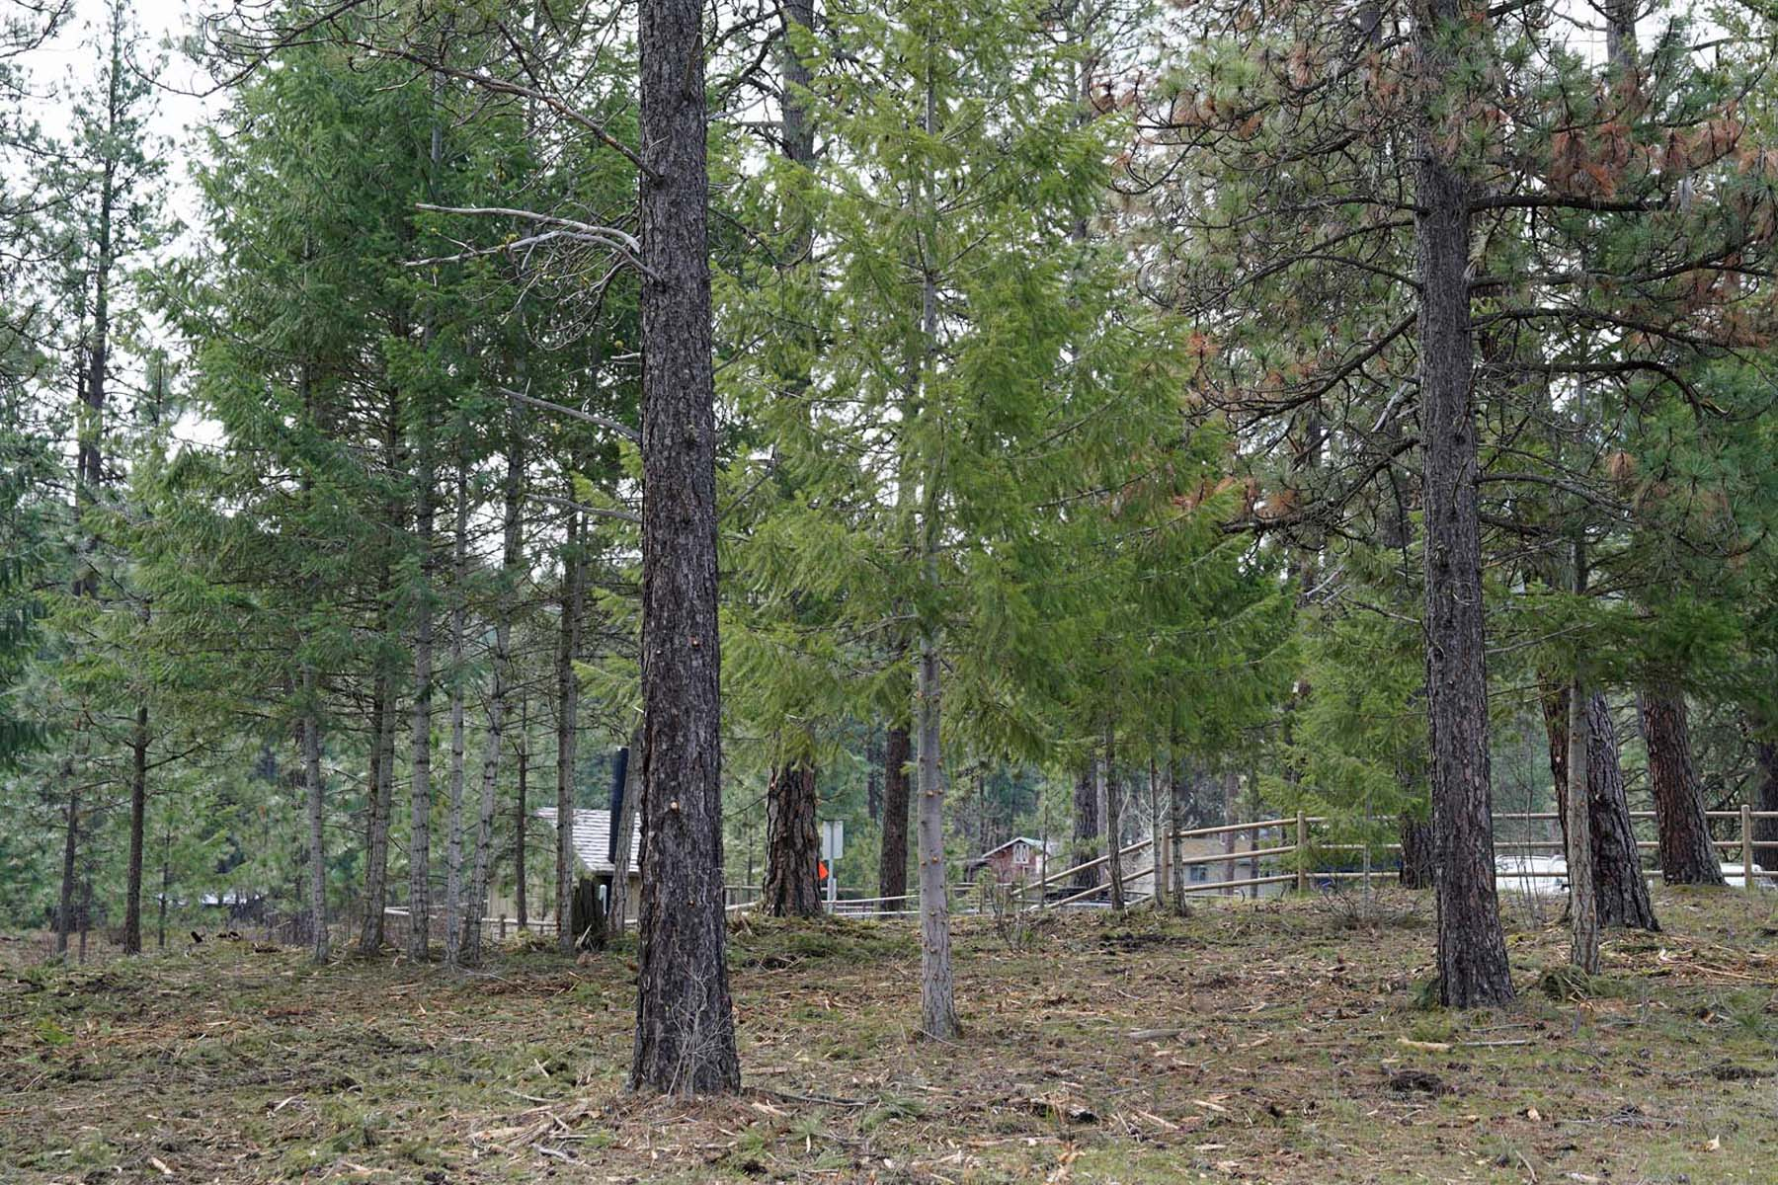
Unit 1 : Post falls community forest
Parkway Fire was a near miss with potential catastrophic impacts
before:
after:

Slide 5
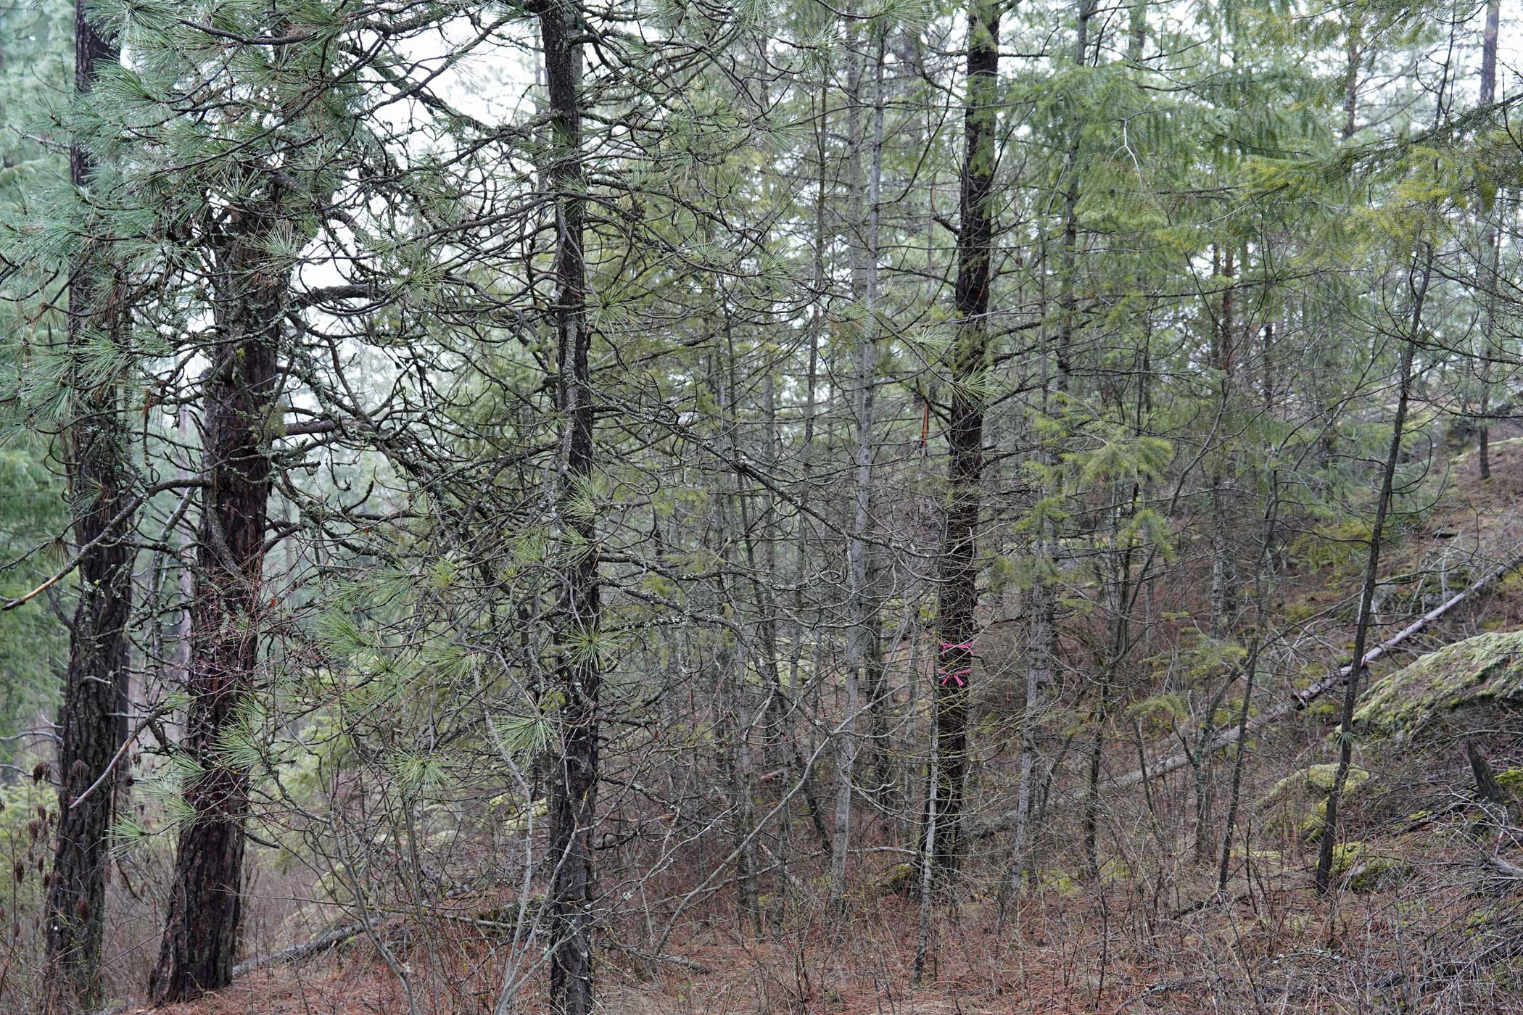
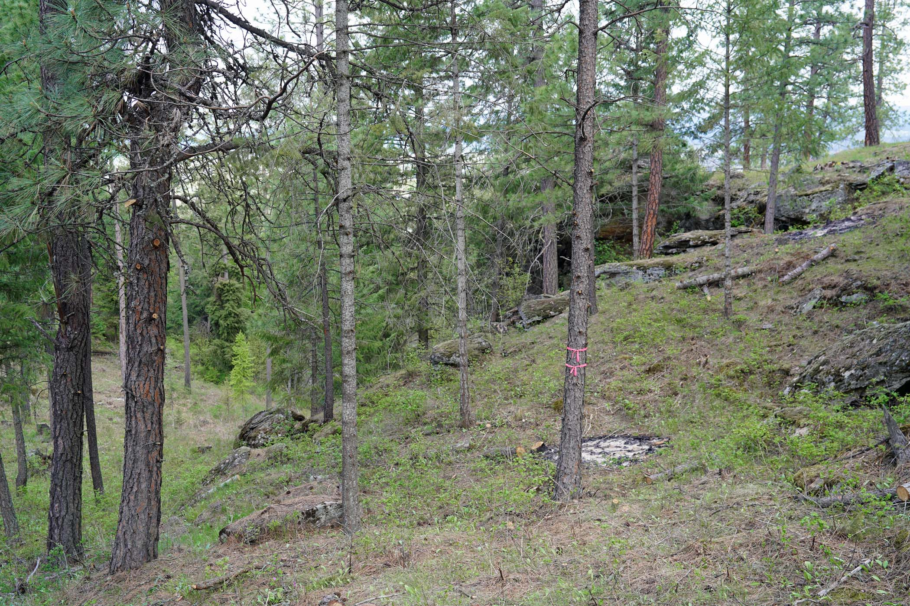
Unit 2 : Farragut State Park
40 acres (3.5 miles) targeted along the Farragut Trail System
before:
after:

Slide 6
Draft PFCF Summary Signage

