Slide 1
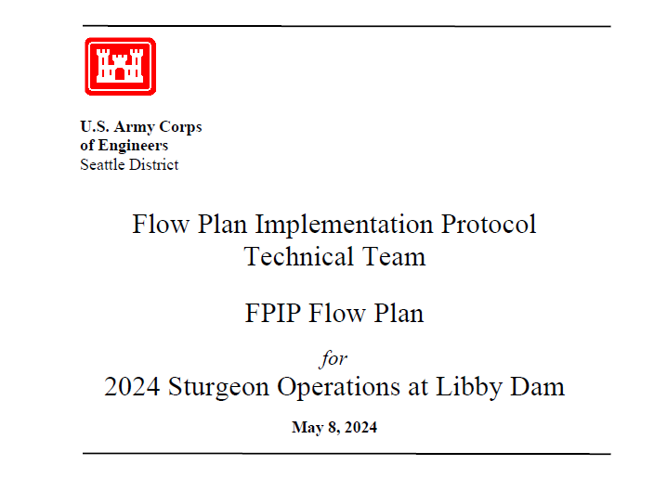
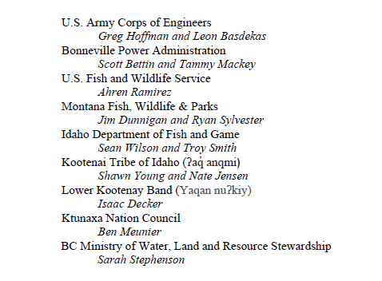

Slide 2
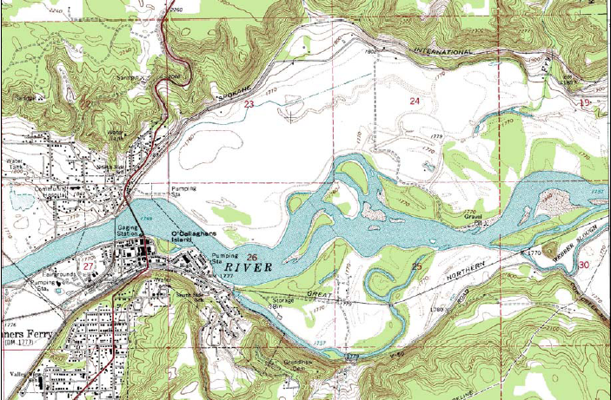
Spring backwater effect
Lake elevation
Coarse
deposition
Fine deposition zone
zone

Slide 3
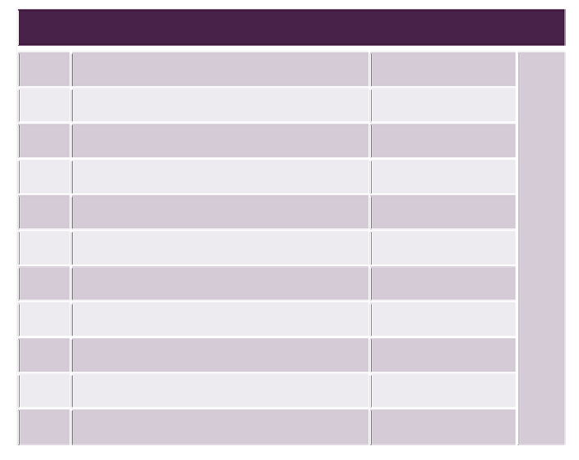
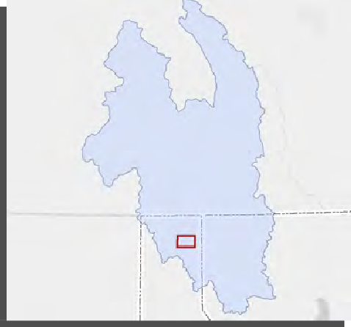
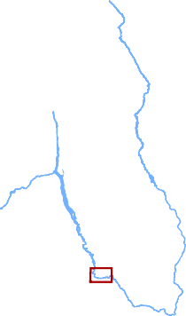
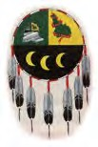
Kootenai River Habitat Restoration Program Projects
Kootenai River Habitat Restoration Program: 2011-2017 Projects
# Project Name
Substrate Enhancement Pilot
Straight Reach Bonners Ferry Islands North Side Channels Lower Meander Middle Meander Upper Meander
Year Built
2014
2015
2015 & 2016
2012
2017 & 2018
2013
2012
Downstream
3
4
5
6
7
£¤95
1
KOOTENAI SUBBASIN
Corra Linn Dam
Kootenay Lake
C A N A D A
W A S H I N G T O N
AREA OF DE
I D A H O
M O N T A N A
8 | Phase 1B | 2011
9 | 1A Extension | 2013
10 | Phase 1A | 2011
TAIL
&
Upstream
Libby Dam
1
£¤²
Moyie Springs
!(
F
Twin Rivers Tribal Sturgeon & Burbot Hatchery
£¤95
9
F
Tribal Sturgeon Hatchery
4
7
8
10
2
Bonners Ferry
!(
3
6
5
Information about the Kootenai Tribe’s restoration programs: www.restoringthekootenai.org
£¤95
Kootenai Tribe of Idaho
P.O. Box 1269, Bonners Ferry, Idaho 83805
£¤²
Funding for this program is primarily from the Bonneville Power Administration through the Northwest Power and Conservation Council’s Fish and Wildlife Program: www.nwcouncil.org
0
0.5
1
2
Miles

Slide 4
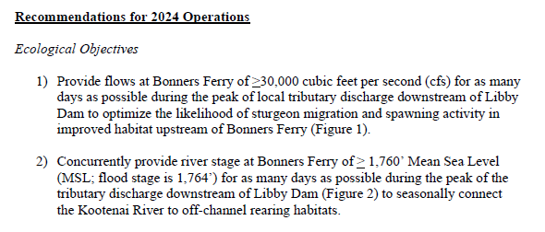

Slide 9
