Slide 1
Idaho DEQ
Kootenai/Moyie Watershed advisory group
May 3rd, 2023

Slide 2
Agenda
Introductions
Selenium in the Kootenai River
Kootenai/Moyie tributary temperature logger discussion
Next meeting date and agenda items
Open discussion
Adjourn

Slide 3
Introductions
Todd Higens
Watershed analyst, Idaho Department of of Environmental Quality
May 3rd, 2023

Slide 4
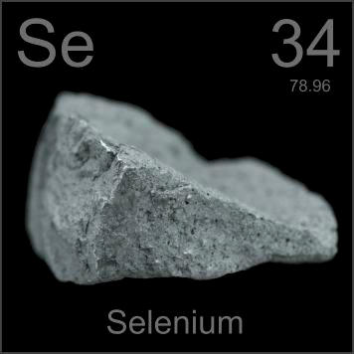
Selenium

Slide 5
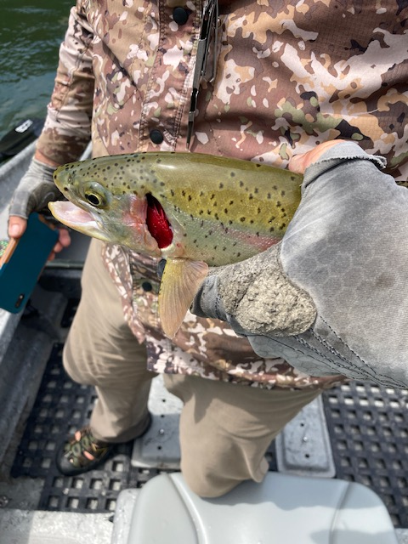
Selenium
Naturally occurring metal in very small trace amounts
Essential for aquatic life in trace amounts
Very toxic to wildlife in elevated concentrations
https://storymaps.arcgis.com/stories/5c8c3b33b1d04adc8157a04455e7eca1
Deformed cutthroat trout in lake Kookanusa,
photo courtesy of the USGS

Slide 6
Current Impairment Status for the Kootenai River
Two Kootenai River Assessment Units are 303d listed as “Not supporting” for the Cold-Water Aquatic Life Beneficial Use. Selenium was listed as a pollutant based on USGS and Kootenai Tribe of Idaho egg/ovary selenium data.
ID17010104PN031_08 - Idaho/Montana to Moyie River
ID17010104PN029_08 – Moyie River to Deep Creek
https://mapcase.deq.idaho.gov/wq2022/default.html

Slide 7
Idaho Selenium Water Quality Standard

Slide 8
Idaho Selenium Water Quality Standard

Slide 9
Source of the Selenium
The selenium pollution is a byproduct of coal mining in Canada
Elk River, British Columbia
Elevated Selenium concentrations have been observed in the Kootenai and Columbia River systems
Affects British Columbia, Montana, Idaho, Washington and the Confederated Salish and Kootenai Tribes
https://storymaps.arcgis.com/stories/5c8c3b33b1d04adc8157a04455e7eca1

Slide 10
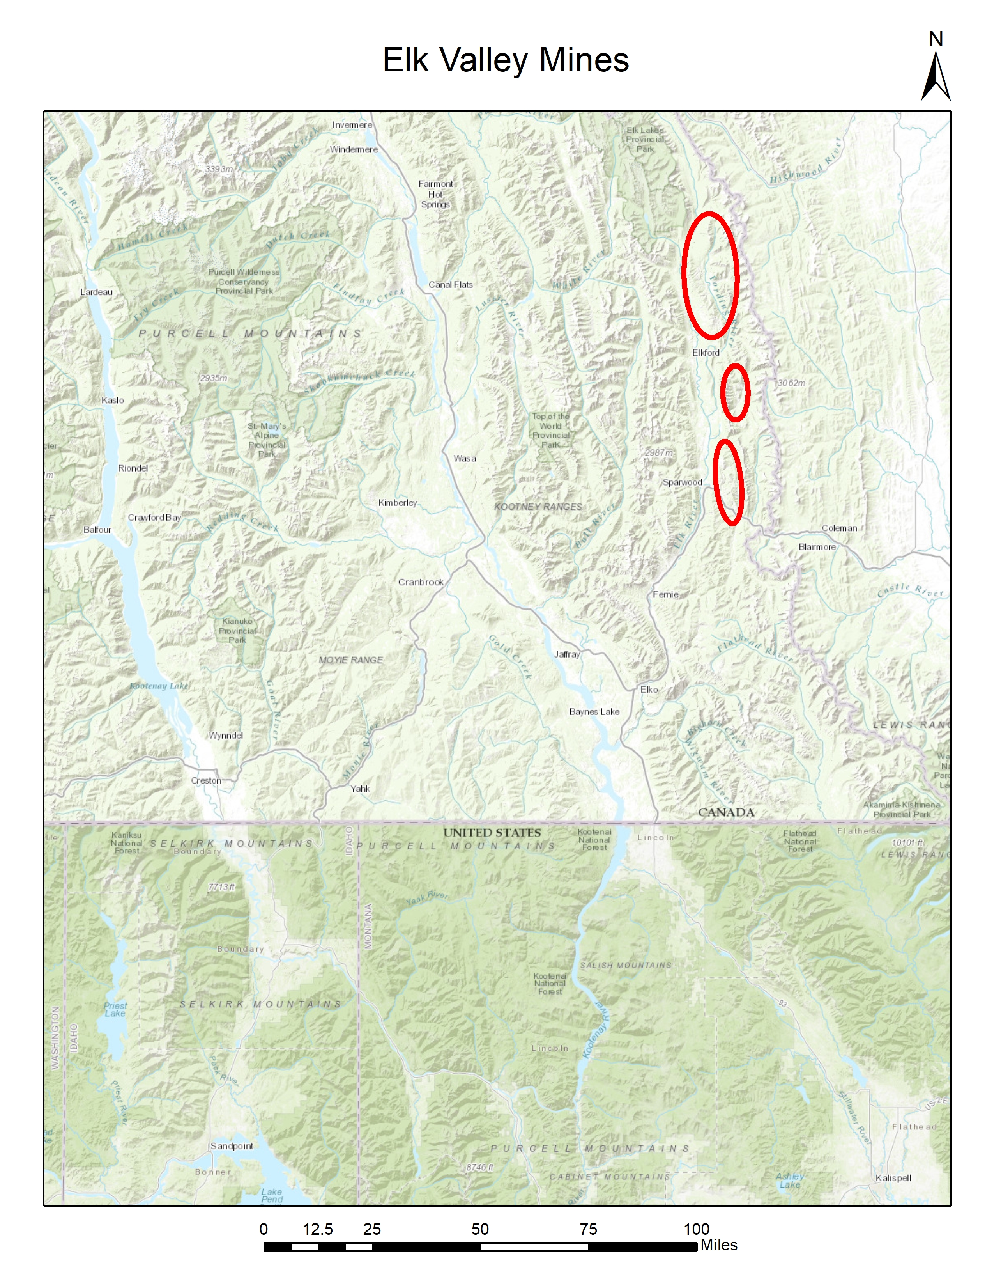
Source of the Selenium

Slide 11
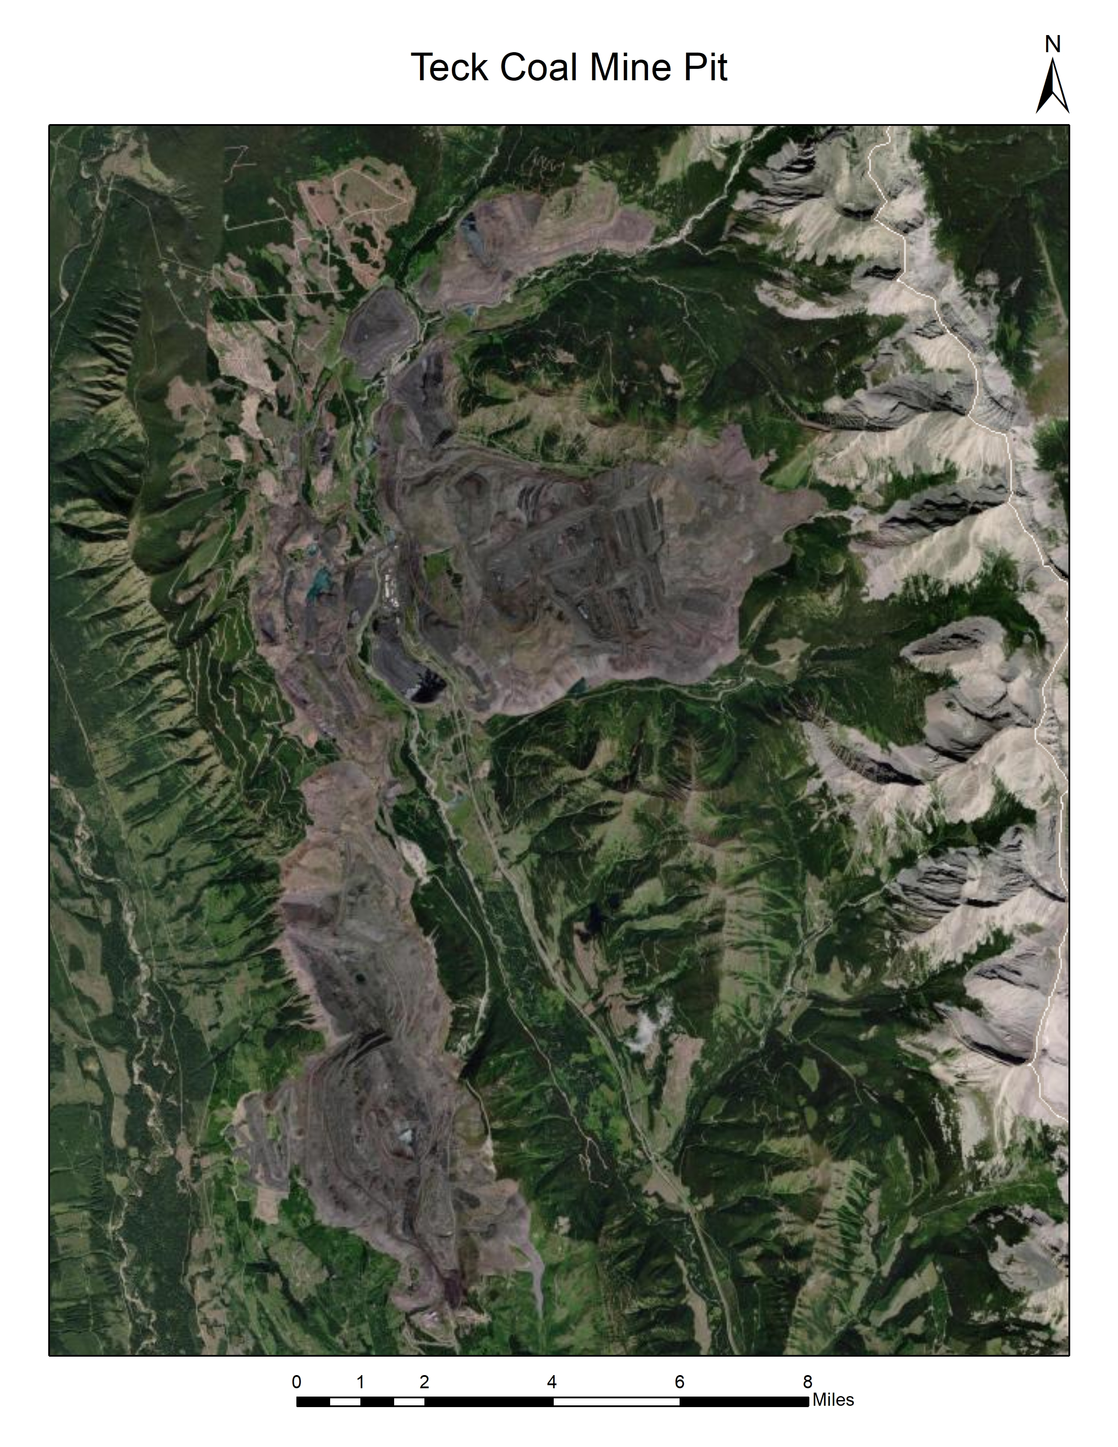
Source of the Selenium

Slide 12
Idaho DEQ Kootenai River Se Monitoring Sites
Twin Rivers Boat Launch
Bonners Ferry Bridge South
Bonners Ferry Bridge North
Copeland Bridge
Copeland Boat Launch
Porthill Boat Launch

Slide 13
Idaho DEQ Kootenai River Se Monitoring Sites (cont.)
Covered under a DEQ Quality Assurance Project Plan (QAPP)
Take samples once a month
Dissolved selenium 0.45 um filter
Temp, conductivity, pH, DO and turbidity

Slide 14
Twin Rivers

Slide 15
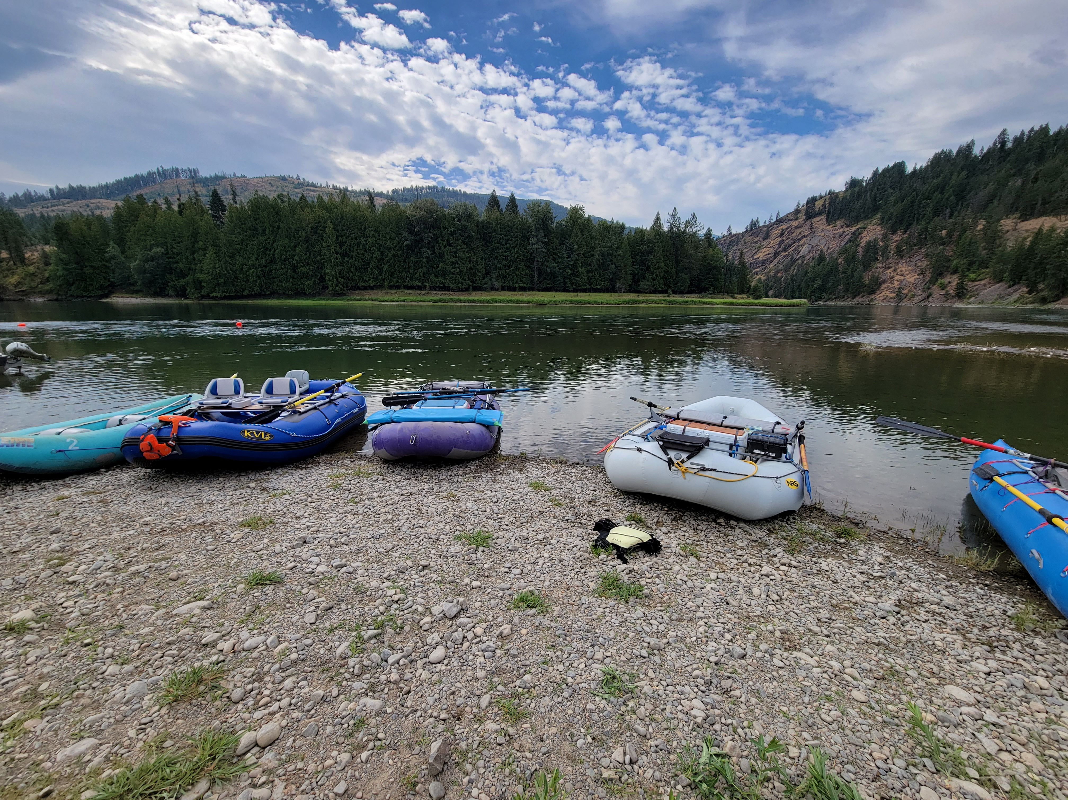
Twin Rivers

Slide 16
Bonners Ferry Bridge South

Slide 17
Bonners Ferry

Slide 18
Bonners Ferry Bridge North

Slide 19
Copeland Bridge

Slide 20
Copeland

Slide 21
Porthill Dock

Slide 22
Kootenai River Tributary monitoring
Some parties have alleged that the geology in Idaho is the source of Selenium
Selenium data for the tributaries will be needed for a future Total Maximum Daily Load

Slide 23
Kootenai River Tributary Monitoring

Slide 24
Tributary Monitoring Results
As of this date, we have dissolved selenium results above the laboratory Detection Limit (DL) of 0.5 - ug/L.

Slide 25
Tributary Monitoring Results

Slide 26
Temperature Loggers?
Current status?
Are more loggers needed?
Are there any specific streams I need to look at for de-listing for temperature or sediment?
https://storymaps.arcgis.com/stories/f8d2ebacf8e343998c762436d1ad775d

Slide 27
Open Discussion
Any old or new concerns?

Slide 28
Next Meeting date?
When should we meet again and what should we discuss?

