Slide 1
Idaho DEQ
Kootenai/Moyie Watershed advisory group
October 23, 2024

Slide 2
Agenda
Introductions
Housekeeping
Selenium TMDL
Temperature Data Discussion
Open discussion
Adjourn

Slide 3
Introductions
Todd Higens
Watershed analyst, Idaho Department of of Environmental Quality
Todd.higens@deq.Idaho.gov

Slide 4
WAG Housekeeping
Integrated Report update
Large River TMDL?
Temperature Criteria Revisions

Slide 5
Integrated Report WAG Consultation
Comment Period is open now!
https://www.deq.idaho.gov/deq-seeks-comment-on-2024-integrated-report/
Notes:
Also 303d list

Slide 6
Selenium The confusing metal
Often sold as a supplement
for people and livestock

Slide 7
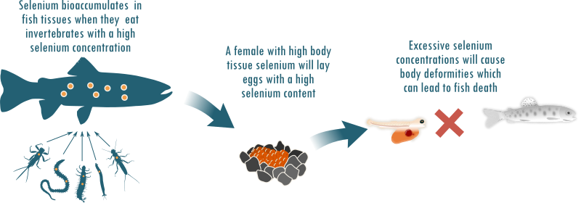
Selenium The Downside
Prosecutors charge husband in the death of Moscow woman
Angela Palermo, Moscow-Pullman Daily News, Moscow, Idaho
Sat, November 27, 2021

Slide 8
Selenium
Naturally occurring metal in very small trace amounts
Essential for aquatic life in trace amounts
Very toxic to wildlife in elevated concentrations
Selenium pollution does not originate in Idaho
https://storymaps.arcgis.com/stories/5c8c3b33b1d04adc8157a04455e7eca1

Slide 9
Current Impairment Status for the Kootenai River
Two Kootenai River Assessment Units are 303d listed as “Not supporting” for the Cold-Water Aquatic Life Beneficial Use. Selenium was listed as a pollutant based on USGS and Kootenai Tribe of Idaho egg/ovary selenium data.
ID17010104PN031_08 - Idaho/Montana to Moyie River
ID17010104PN029_08 – Moyie River to Deep Creek
https://mapcase.deq.idaho.gov/wq2022/default.html

Slide 10
Selenium
DEQ has collected selenium data for the last three years
Average Se concentration is 1 ug/L
56.0 pounds of selenium a day (rough calculation)

Slide 11
Future Se TMDL
Waiting to coordinate with Montana
EPA contractors may write the TMDL

Slide 12
Tributary Monitoring Results
So far, we have not seen any tributary samples with a dissolved selenium concentration above the laboratory Detection Limit (DL) of 0.5 - ug/L.

Slide 13
Temperature

Slide 14
What I have been up to!
I have been analyzing temperature data from the Kootenai/Moyie and Priest Lake basins along with Idaho Falls Regional data to determine what factors influence stream temperature.

Slide 15
Factors that influence Stream Temps
Aspect
Elevation
Stream Order
Gradient/morphology
Canopy cover
Groundwater influence
Bankfull width

Slide 16
Stream Temperature prediction Model
Notes:
Indian Creek at Priest

Slide 17
DEQ’s attempt to revise our Temperature Criteria.
The current criteria is problematic
DEQ is exploring the idea of trying for a new temp criteria
May be modeled for local watersheds
It will be a tough task!

Slide 18
Future Work on Temperature and Other Stream Characteristics.
Refine my temperature prediction model and write a white paper
Start looking at flows to see if logging influences temperature
Start modeling sediment in the Kootenai/Moyie Watersheds

Slide 19
Questions or Comments

Slide 20
Thank you!
Todd Higens
Todd.higens@deq.Idaho.gov
208-769-1422

