Slide 1
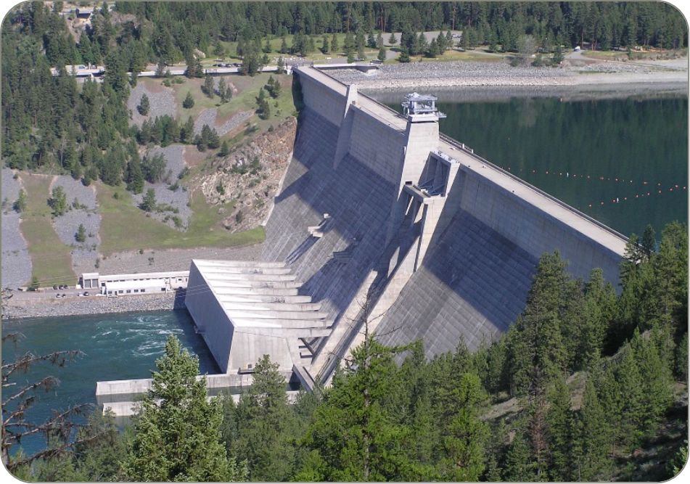
Libby dam water management
March 2024 kvri update
Leon Basdekas
Upper Columbia River Senior Water Manager
18 March 2024

Slide 2
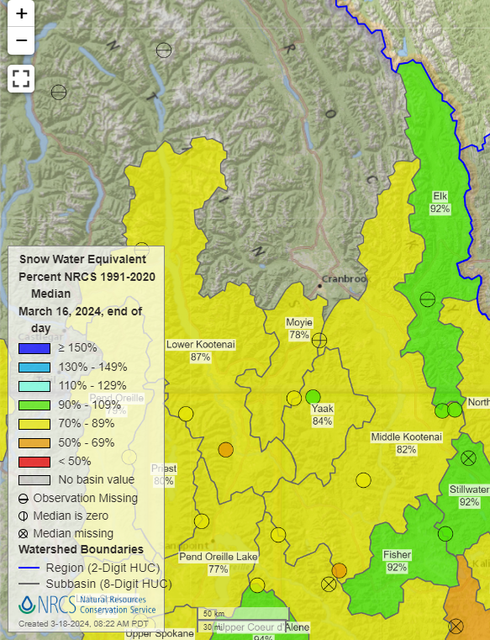
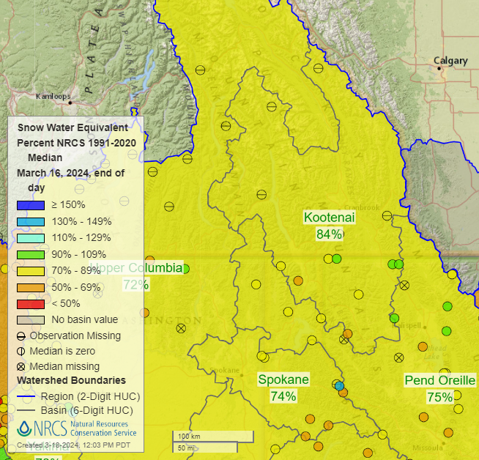
Snow Water equivalent
Snowpack is below average (84%) for Mid-March in the Kootenai Basin.
Predictive ability this early in the snow season is low for summer flows.

Slide 3
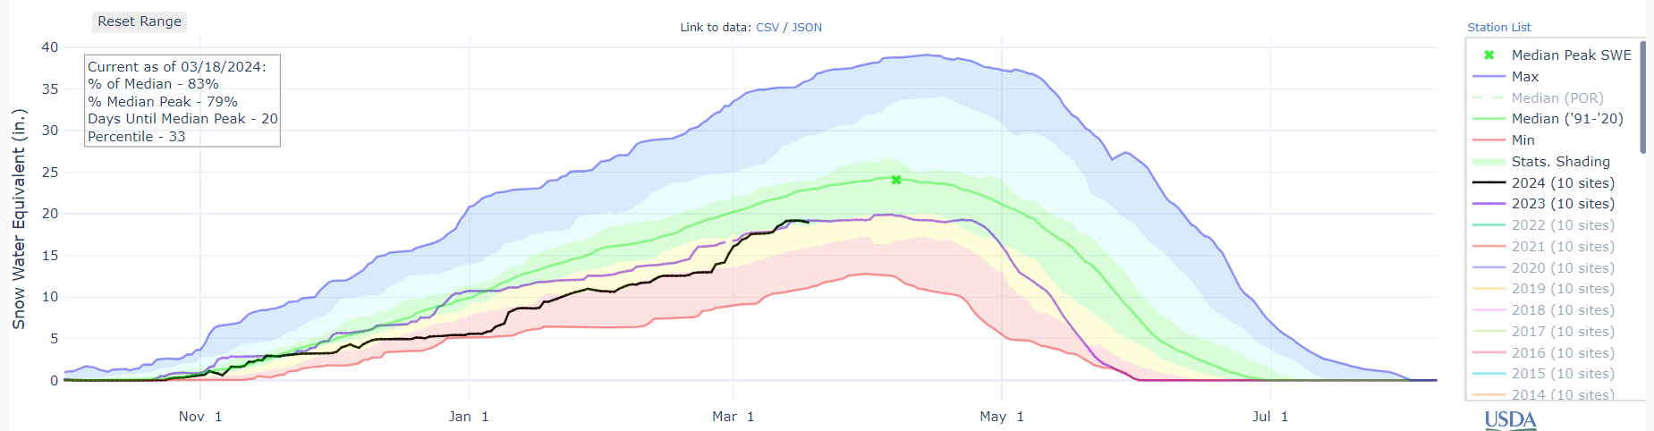
Snow Water equivalent

Slide 4
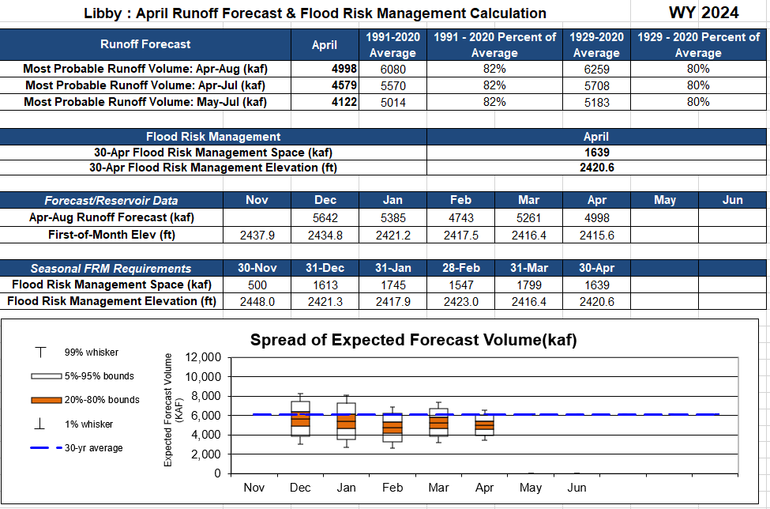
Unofficial Water Supply Forecast (April Earlybird 2024) – Dry remainder of month
Last year - March dry earlybird was 4.84 maf
Notes:
If WSF holds, SP 0.8 maf , 7 kcfs bull trout min, July – Aug.

Slide 5
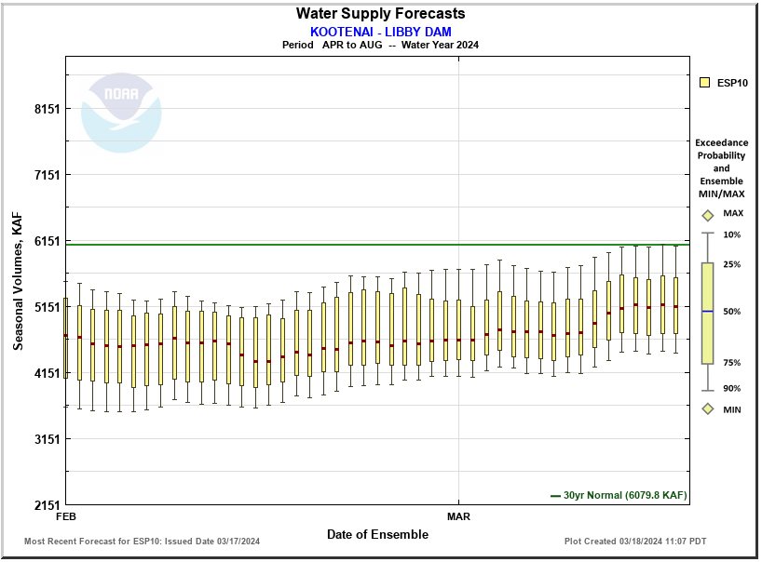
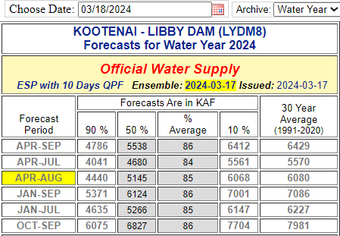
Northwest river forecast center
4.64 maf
5.15 maf
Current ESP water supply forecast for Apr-Aug 2024 is also below average.
Still possible to have more snow accumulation this.

Slide 6
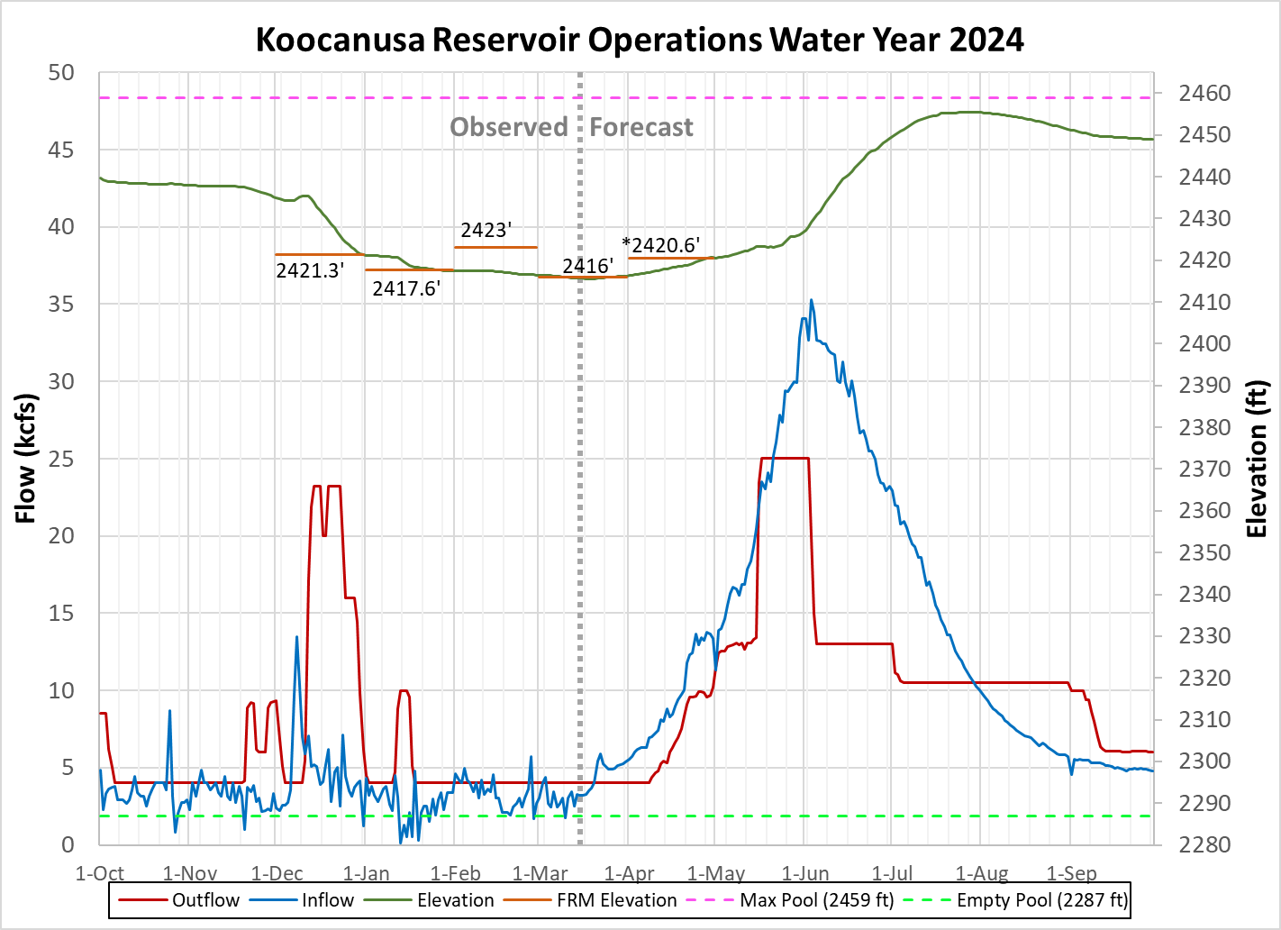
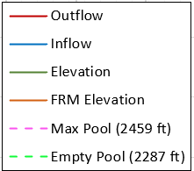
Sturgeon Pulse Operation May - June 2024
* Preliminary and subject to change

Slide 7
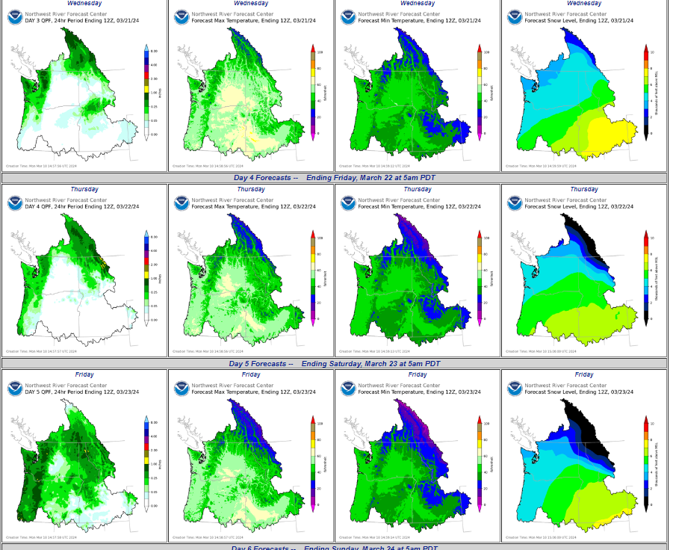
Weather this week

Slide 8
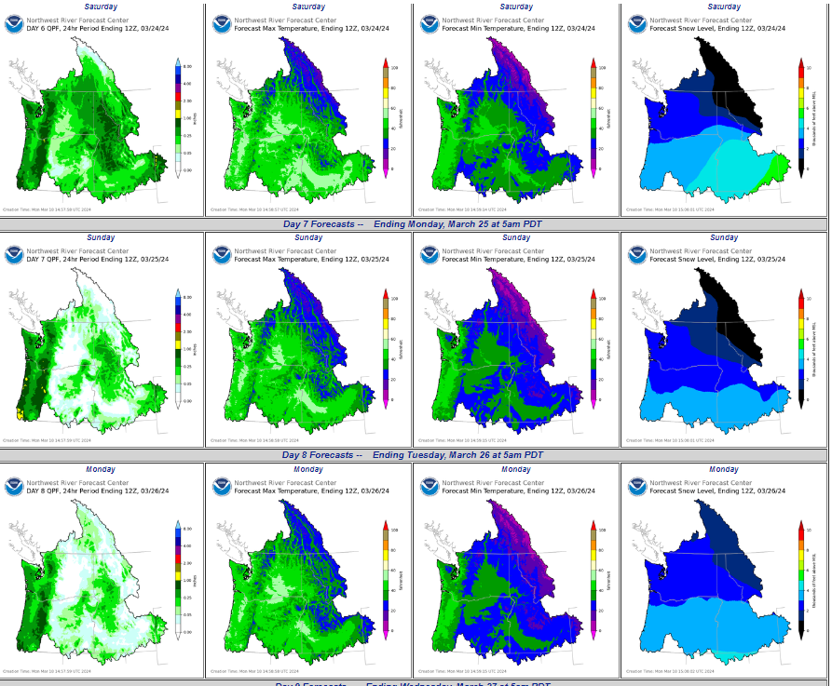
Weather this week

Slide 9
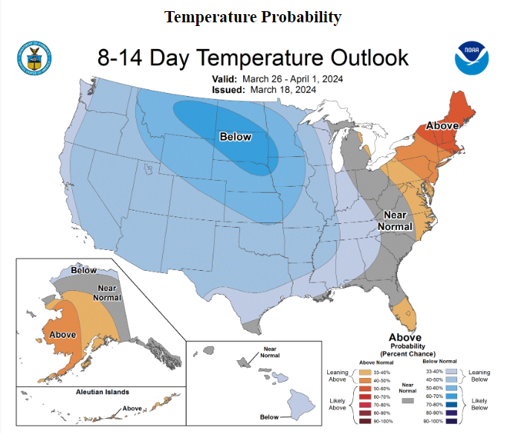
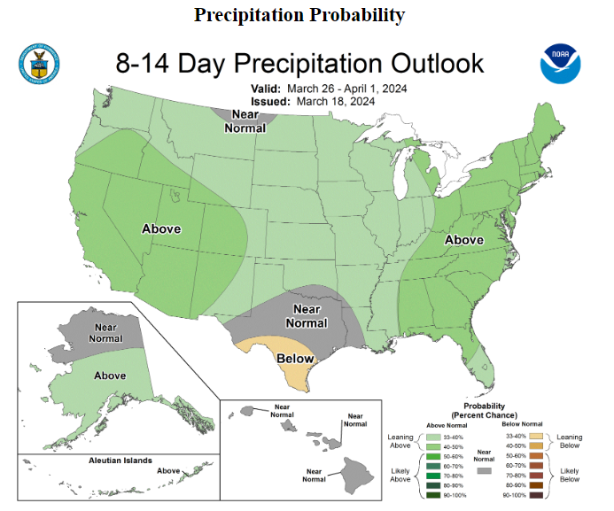
Week two outlook

Slide 10
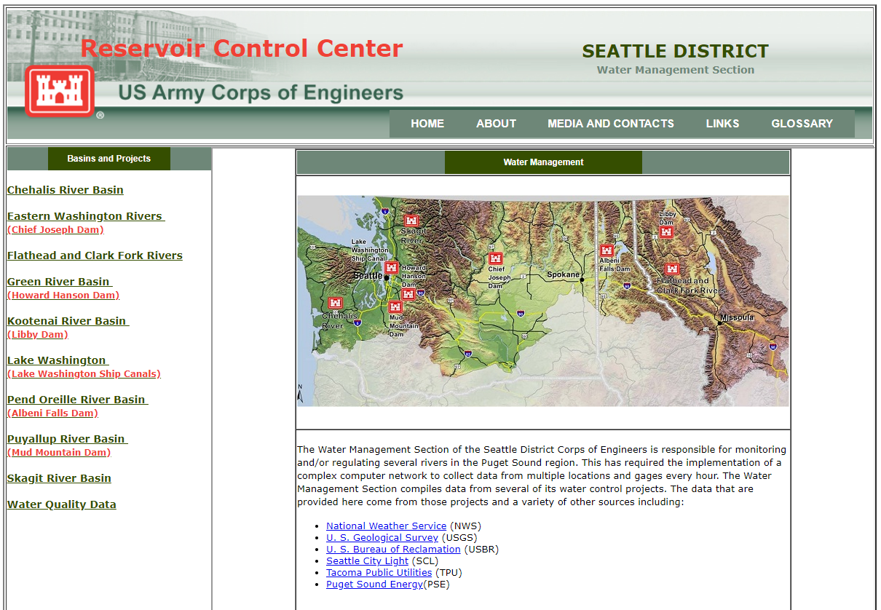
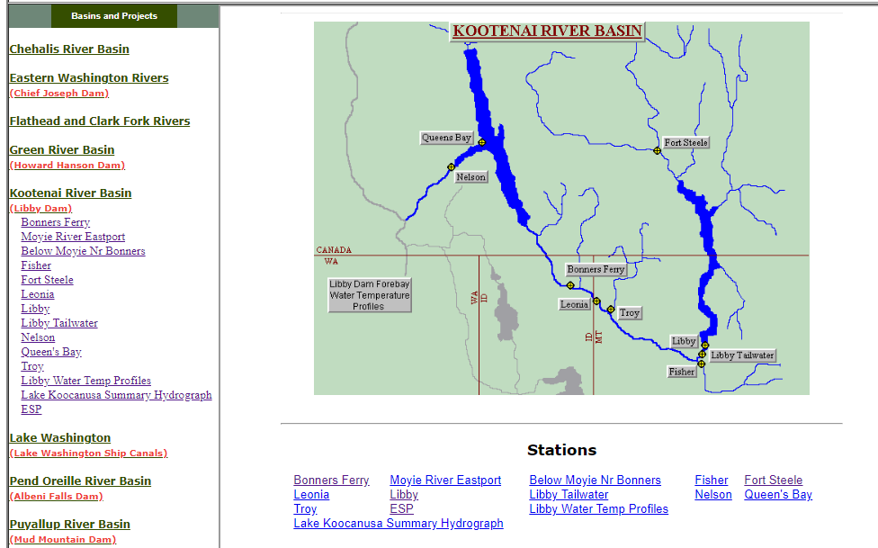
Questions?
For emails regarding release changes and lake level updates email
  UpperColumbiaWM@usace.army.mil
  leon.basdekas@usace.army.mil
General Queries call (206) 764-6702
Seattle District water management data website :
http://www.nwd-wc.usace.army.mil/nws/hh/www/index.html#

Slide 11
Ensemble Streamflow Prediction (ESP)
Northwest River Forecast Center (NWRFC) currently uses ESP technique to make water supply forecasts for the Columbia River Basin.
Modeling system to simulate soil moisture, snowpack, regulation, and streamflow.
  Uses the current hydrologic conditions, and
  Then uses historical meteorological data to create equally likely sequences of future hydrological conditions, each starting with the current hydrological conditions.
Statistical analysis is performed on these sequences to generate probabilistic forecasts of seasonal water supply

